Slide 1

Bootstrapping Intelligence: Getting started with Deep Reinforcement Learning
By Bruce Nielson (brucenielson1@gmail.com)

Slide 2


Slide 3
About me
I graduated from Georgia Institute of Technology with a Masters in Computer Science specializing in Machine Learning
I currently work for Get Predictive as a Data Scientist / Programmer
I’m a huge fan of the Physicist David Deutsch and the Philosopher Karl Popper
I want to help invent AGI
Follow me on Twitter: https://twitter.com/bnielson01
My very nerdy podcast is “The Theory of Anything”: https://anchor.fm/four-strands
Covers science, philosophy, machine learning, Marvel and Star Wars, etc.

Slide 4
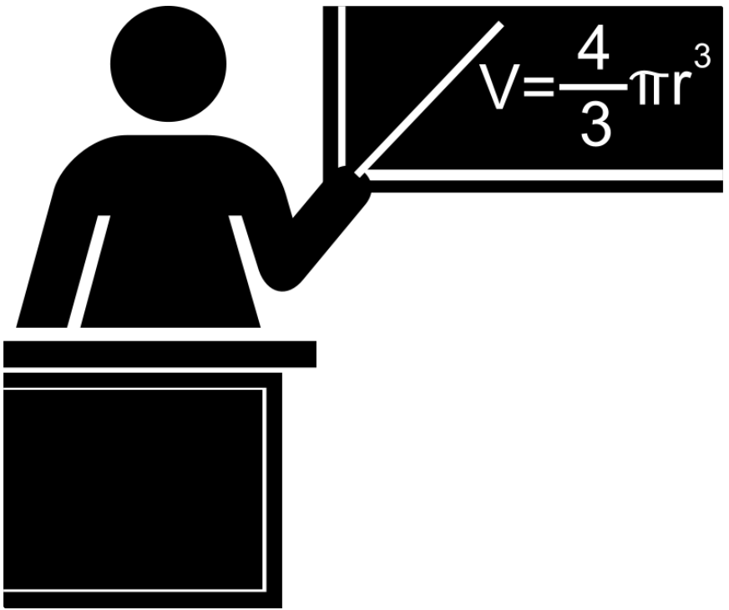

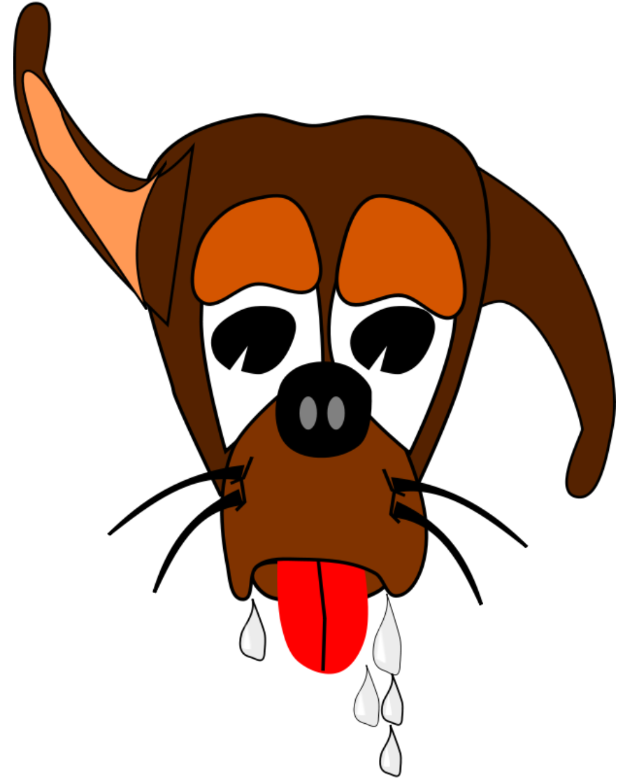
Types of Machine Learning
Supervised Learning
Unsupervised Learning
Reinforcement Learning

Slide 5
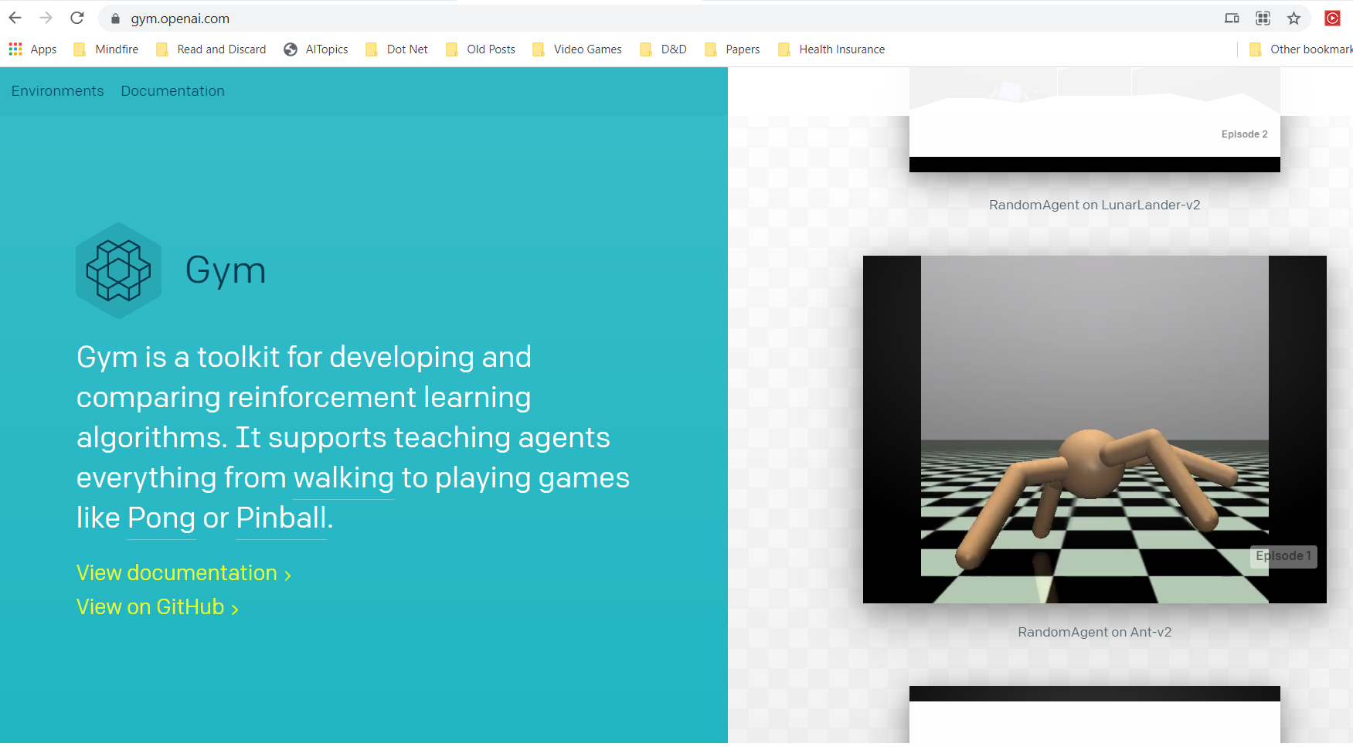
Openai gym

Slide 6
Reinforcement Learning
Characteristics of Reinforcement Learning:
Exploration
Delayed Rewards
Continuous Learning
Similar to Supervised in that there are rewards for “good behavior” (similar to a loss function)
Similar to Unsupervised in that you have no “correct results” to work with
However, “Semi-Supervised Learning” is a different thing all together
Question: Why was Reinforcement Learning able to beat a Go master where other types of Artificial Intelligence failed to do so?

Slide 7
The Markov Decision Process (MDP)
S = States agent can be in
A = Actions agent can take
At time t, the agent senses current state: S_{t}
Agent takes action A_{t}
The environment gives reward R_{t} in response and moves agent to state S_{t+1}:
δ(S_{t}, A_{t}) = S_{t+1}(State Transition Function)
r(S_{t}, A_{t}) = R_{t} (Reward Function)
Key Assumption: Those two functions depend only on current state/action
Not previous ones!
Less limiting than it sounds – any past state info can be ‘promoted’ to be part of the current state

Slide 8
Example of Markov Decision Process
States and Actions

Slide 9
Optimal Policy
An optimal policy conceptually looks like this:

Slide 10
Optimal value function and optimal policy
The Optimal Value Function:
An optimal policy can be created from the optimal value function

Slide 11
Q-Function and Optimal Value Function
The Q-Function is the expected value of a given state and action:
The Optimal Value Function can be created from the Q-Function:
72.9
81
90
65.61
72.9
72.9
81
90

Slide 12
But how do I calculate the value function/Q function?
States and Actions
If I have the transition function and reward function, I could calculate the optimal value function directly using dynamic programming

Slide 13
It is possible to approximate the Q-function…
We use the Bell Equation in the following form:
Where the Q-Function is recursively defined in terms of itself
This allows us to iteratively approximate Q with no knowledge of the transition function or reward function!
Start with a table of Q values for every state/action pair
Initial ‘estimate’ for the Q values can be all zeroes or even random values. Then follow this algorithm:
Q-Learning Algorithm:
Select an action a and execute it
Receive immediate reward r
Observe the new state s’ (s’ becomes new s)
Update the table entry as follows:

Slide 14
Q-Learning in Practice
Current State = 7 (Start)
States and Actions
Q-Learning Algorithm:
Select an action a and execute it
Receive immediate reward r
Observe the new state s’ (s’ becomes new s)
Update the table entry as follows:
def updateQ(self, s, a, s_prime, a_prime, r):
# Update Q table (s_prime is next state and a_prime is max (optimal) move from s_prime
self.Q[s, a] = ((1.0 - self.alpha) * self.Q[s, a]) + (self.alpha * (r + (self.gamma * self.Q[s_prime, a_prime])))

Slide 15

Q-Learning in Practice
1
2
3
4
5
6
7
8
9
Q[s, a] = (0.8 * Q[s, a]) + (0.2 * (reward + 0.9 * Max Q[s_prime, a_prime]))
Q[s, a] = (0.8 * 0) + (0.2 * (0 + 0.9 * 0))
Q[s, a] = 0

Slide 16
Q-Learning in Practice
1
2
3
Goal! Reward 100!
4
5
6
7
8
9
Q[s, a] = (0.8 * Q[s, a]) + (0.2 * (reward + 0.9 * Max Q[s_prime, a_prime]))
Q[2, R] = (0.8 * Q[s, a]) + (0.2 * (reward + 0.9 * Max Q[s_prime, a_prime]))
Q[2, R] = (0.8 * 0) + (0.2 * (100 + 0.9 * 0))
Q[2, R] = 20

Slide 17
Q-Learning in Practice
1
2
3
4
5
6
7
8
9
Q[s, a] = (0.8 * Q[s, a]) + (0.2 * (reward + 0.9 * Max Q[s_prime, a_prime]))
Q[1, U] = (0.8 * Q[s, a]) + (0.2 * (reward + 0.9 * Max Q[s_prime, a_prime]))
Q[1, U] = (0.8 * 0) + (0.2 * (0 + 0.9 * 20))
Q[1, R] = 3.6

Slide 18
Q-Learning in Practice
1
2
3
Goal! Reward 100!
4
5
6
7
8
9
Q[s, a] = (0.8 * Q[s, a]) + (0.2 * (reward + 0.9 * Max Q[s_prime, a_prime]))
Q[2, R] = (0.8 * Q[s, a]) + (0.2 * (reward + 0.9 * Max Q[s_prime, a_prime]))
Q[2, R] = (0.8 * 20) + (0.2 * (100 + 0.9 * 0))
Q[2, R] = 36

Slide 19
Q-Learning in Practice: Explore, Exploit, Converge!
1
2
3
81
90
100
4
5
6
72
81
81
90
100
7
8
9
81
90
Problem: Once a path performs ‘best’ how would you discover a better path?
Solution: The Exploit / Explore Trade-off, i.e. random moves with decaying occurrence

Slide 20
Demo
Maze Path:
array([[3, 8, 8, 0, 0, 0, 0, 0, 0, 0],
[0, 0, 8, 8, 8, 8, 0, 0, 0, 0],
[0, 0, 0, 0, 0, 8, 8, 8, 0, 0],
[0, 0, 1, 1, 1, 1, 1, 8, 0, 0],
[0, 5, 1, 0, 0, 0, 1, 8, 0, 0],
[0, 5, 1, 0, 0, 0, 1, 8, 0, 0],
[0, 0, 1, 0, 0, 0, 1, 8, 0, 0],
[0, 0, 0, 0, 0, 0, 8, 8, 0, 0],
[0, 0, 0, 0, 0, 8, 8, 0, 0, 0],
[0, 0, 0, 0, 8, 8, 0, 0, 0, 0]]
maze = u"""3, 0, 0, 0, 0, 0, 0, 0, 0, 0 0, 0, 0, 0, 0, 0, 0, 0, 0, 0 0, 0, 0, 0, 0, 0, 0, 0, 0, 0 0, 0, 1, 1, 1, 1, 1, 0, 0, 0 0, 5, 1, 0, 0, 0, 1, 0, 0, 0 0, 5, 1, 0, 0, 0, 1, 0, 0, 0 0, 0, 1, 0, 0, 0, 1, 0, 0, 0 0, 0, 0, 0, 0, 0, 0, 0, 0, 0 0, 0, 0, 0, 0, 0, 0, 0, 0, 0 0, 0, 0, 0, 2, 0, 0, 0, 0, 0"""
Optimal Policy:
[['3' '<' '<' '<' '<' '<' 'v' '<' '<' '<']
['^' '<' '^' '<' '<' '<' '<' '<' '<' '<']
['^' '<' '^' '^' '^' '^' '<' '<' '<' '<']
['^' '^' '1' '1' '1' '1' '1' '^' '^' '^']
['<' '5' '1' '^' 'v' '^' '1' '^' '<' '<']
['v' '5' '1' '^' 'v' '>' '1' '^' '<' '^']
['>' '<' '1' '>' 'v' 'v' '1' '^' '^' '<']
['>' '>' '^' '>' '>' '>' '>' '^' '<' 'v']
['<' '<' '^' '>' '>' '>' '^' '^' 'v' 'v']
['>' '<' 'v' '>' '>' '^' '^' '^' '^' '<']]

Slide 21
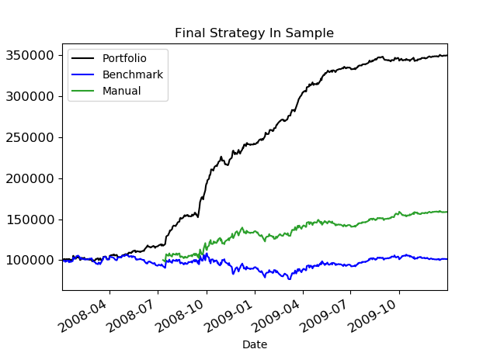
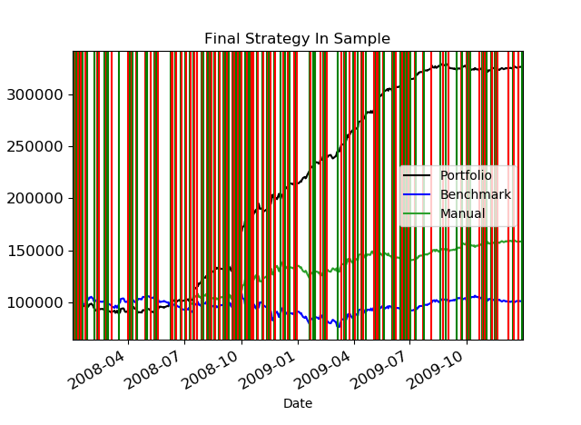
Demo

Slide 22
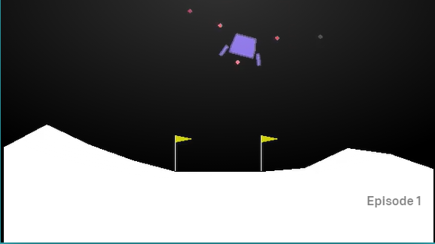
Lunar Lander
In 1973 Lunar Lander was created to show off the DEC GT40 (Texted based)
Atari published an arcade version in 1979 (Graphic version)
(Source Wikipedia)

Slide 23
Lunar lander
Actions for this game are:
Do nothing
Fire left orientation engine
Fire right orientation engine
Fire main engine
Note: All actions are distcrete, i.e. off or on
Source: Solving The Lunar Lander Problem under Uncertainty using Reinforcement Learning by Gadgil, et al

Slide 24
Lunar lander
“State” for this game consists of 8 values:
X Position (real)
Y Position (real)
X Velocity (real)
Y Velocity (real)
Angle of lander (real)
Left leg contact with ground? (bool)
Right leg contact with ground? (bool)
Source: Solving The Lunar Lander Problem under Uncertainty using Reinforcement Learning by Gadgil, et al
Problem: 6 of those are real values and are continuous. So the state space is infinite.
How do you use Q-Learning on such a state space?

Slide 25
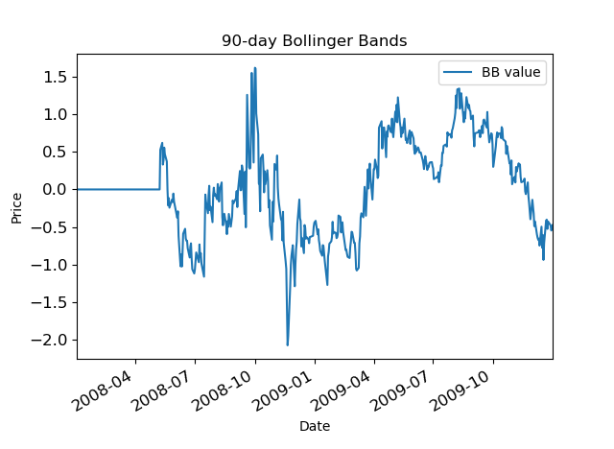
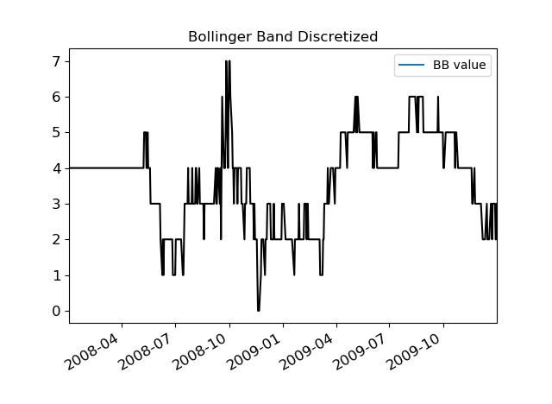
Approach 1: Discretize

Slide 26
Outcome of discretization
Even with a Q-Table with 1,000,000 state/action pairs the lander did little more than sort head towards the middle while crashing
Problem: I couldn’t seem to play the game nearly enough to fill up the Q-table. Most of the table stayed at zeroes and thus gave bad information

Slide 27
Approach 2: Deep Reinforcement Learning
Intuition: Neural Nets can theoretically approximate any function
This is called the Universal Approximation Theorem
Source: Multilayer Feedforward Networks are Universal Approximators by Kurt Hornik
A Q-Table is just a function:
Q-Function(State, Action) returns Q-Value which is the current known value of being in that state and taking that action
Why not just use a neural network to approximate the Q-Function?

Slide 28
Deep Reinforcement Learning
New problem: How do you train a neural net to replace the Q-Function?
Normally we use supervised learning to train neural nets which requires a human to label ‘ground truth.’
But we have no ‘ground truth’ to work with here
Proposed solution:
Let the neural net train itself!
I have no idea who came up with it but it sounds absurd to me
But it turns out it actually works!

Slide 29
Track the following
(state, action, reward, next state, done?)
State: All 8 values
Action taken
Reward received, if any
New state you found yourself in after the action
Did the episode end? (Crash or success)
Train off of this history by grabbing a mini-batch of a random 100 elements

Slide 30
Deep reinforcement Learning
def update_q_model(self, state: int, action: int, reward: float, new_state: object, done: bool = False, gamma: float = 0.9):
# Get samples in mini-batches
samples = random.sample(self._history, row_count)
# Separate into separate arrays
states_array = [sample[state] for sample in samples]
actions_array = [sample[action] for sample in samples]
rewards_array = [sample[reward] for sample in samples]
next_states_array = [sample[next_state] for sample in samples]
done_array = [sample[done] for sample in samples]

Slide 31
Deep reinforcement Learning
def update_q_model(self, state: int, action: int, reward: float, new_state: object, done: bool = False, gamma: float = 0.9):
(continued)
# Create y (i.e. labels for supervised learning)
predicted_values = self._model.predict_on_batch(states_array)
next_predicted_values = self._model.predict_on_batch(next_states_array)
actual_values = rewards_array + gamma * np.amax(next_predicted_values, axis=1) * done_array
actual_values[list(range(row_count)), actions_array] = actual_values
# Update network
self._model.fit(states_array, actual_values, epochs=1, verbose=0)
Predict Action for State
you were just in
Predict Action for New State
Create ‘actuals’ from next prediction
Train network from our ‘actual’ values

Slide 32
Final result
We rip out the Q-Table and replace it with a neural net that takes states as an input and outputs an action.
This effectively replaces the Q-Table because we really only use it to determine, given a state, which action to take.
But neural nets naturally generalize well, so we don’t need to come up with enough tests to hit every single ‘state’
Plus, for free, we can now handle continuous (read: infinite) state spaces

Slide 33
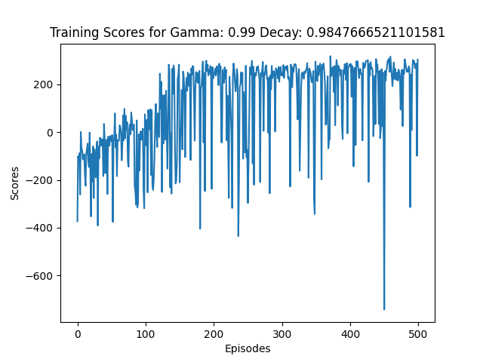
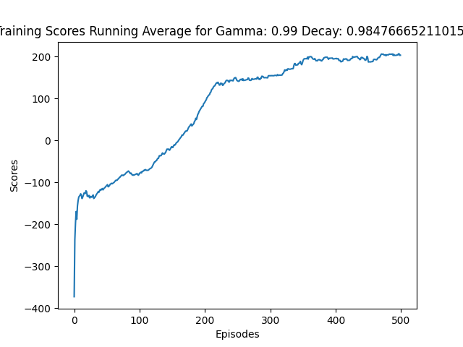
Final Result

Slide 34
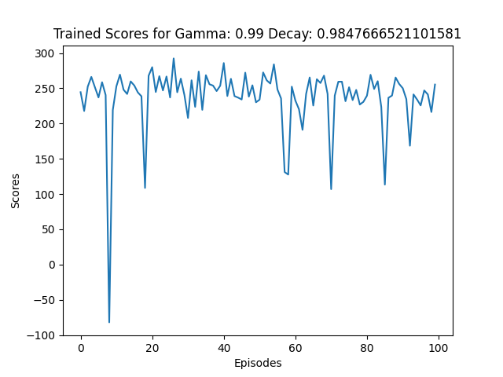
Final result

Slide 35
My github code base
Warning:
Setting up the environment for OpenAI is difficult. I have yet to document it. But I just googled around until I got it working.
Built using Python/Keras/Tensorflow
File: q_learner_interfaces.py
Contains a set of interfaces for either regular Q-Learning or Deep Reinforcement Learning
IQModelInterface: Interface for either a true Q-Table or a Deep Reinforcement Learning approximation of a Q-Table
IQLearnerInterface: Interface for either a Q-Learner of a Deep Reinforcement Learning approximation of a Q-Learner
Note: 90% of the code for both types of learners is all done for you! (394 lines)
The code tries to start with semi-good hyper parameters for any reinforcement learning problem

Slide 36
My github code base
File: q_table.py
Contains actual code for a Q Table for a classical Q Learner built on top of IQModelInterface
49 lines of code
File: q_learner.py
Contains actual code for a Q Learner built on top of IQLearnerInterface
48 lines of code
File: environments.py
A wrapper for either an OpenAI Gym environment or one you built yourself (e.g. grid world)
Basically just wraps: reset environment, make a step in the environment, or render the environment visually.

Slide 37
My github code base
File: dqn_model.py
Contains actual code for a Deep Q Network (DQN) model built on top of IQModelInterface
98 lines of code
File: dqn_learner.py
Contains actual code for a DQN Learner built on top of IQLearnerInterface
18 lines of code
File: open_gym_examples.py
Contains examples of me using the other files to create real reinforcement agents trained to solve actual OpenAI Gym problems
I used this approach to make it very clear what the difference between regular Q Learning and Deep Q Learning really are. You can see I literally just rip out the Q-Table and replace it with a neural network.

Slide 38
My github code base
Code Base: https://github.com/brucenielson/Reinforcement-Learning
You will find the slides for this presentation there as well
I plan to continue improving on this
OpenAI Gym: https://gym.openai.com/
https://gym.openai.com/envs/LunarLander-v2/

Slide 39
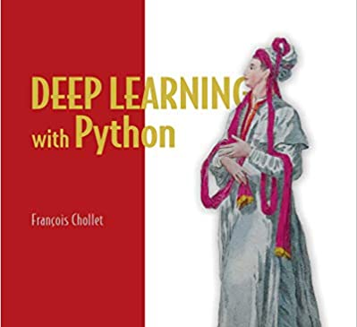
Learning Keras
Francois Chollet, author of Keras, wrote this book
It’s an excellent beginner/intermediate level intro not only to Keras but to the entire Deep Learning field

Slide 40
Demo

